Slide 1

Dice Rolling Simulation
Shees Ul Haq -191
Malik Shahnawaz Hadi -190
Hadabia Amjid -182
Noor Fatima -163

Slide 2
introduction
Our project is on a game which is about a DICE ROLLING SIMULATION with one or more than one dice, This project will help us to roll one or more than dice which makes the game more enjoyable, In that project we will get six (6) dice, which based on our choice whether we roll one dice or more than one dice,

Slide 3
Problem
Two dice: Majority of dice rolling games are based on two dice, where user won’t enjoy the game due to it’s limits.

Slide 4
Goals
User Friendly: Our goal is to create a user friendly game where user get the desirable dice. It’s provide a interface to the user to make the game more interesting
Improvement: We improve the game by making the choice of selecting Dice. That how many dice user wants to play with and we also improve the speed and interface of the game.

Slide 5
Objectives
To develop a user friendly dice rolling simulation
To develop a efficient game
To develop a interesting game
To develop a game which give a good impact on user

Slide 6
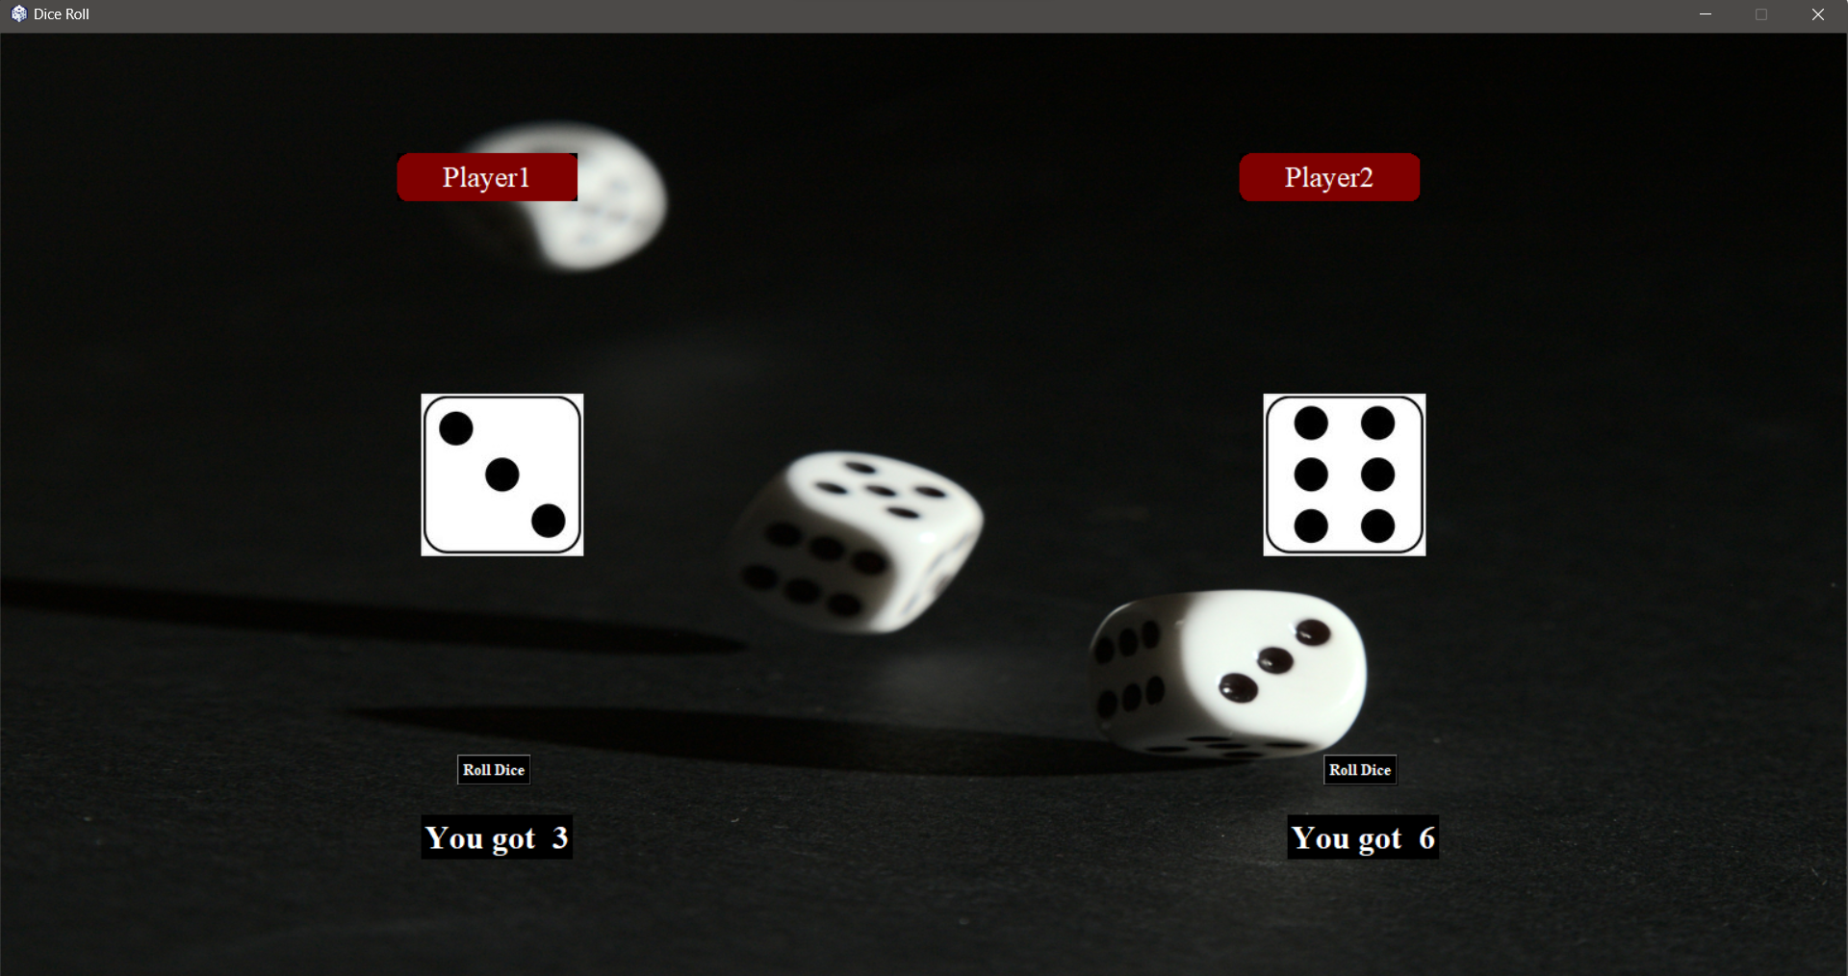
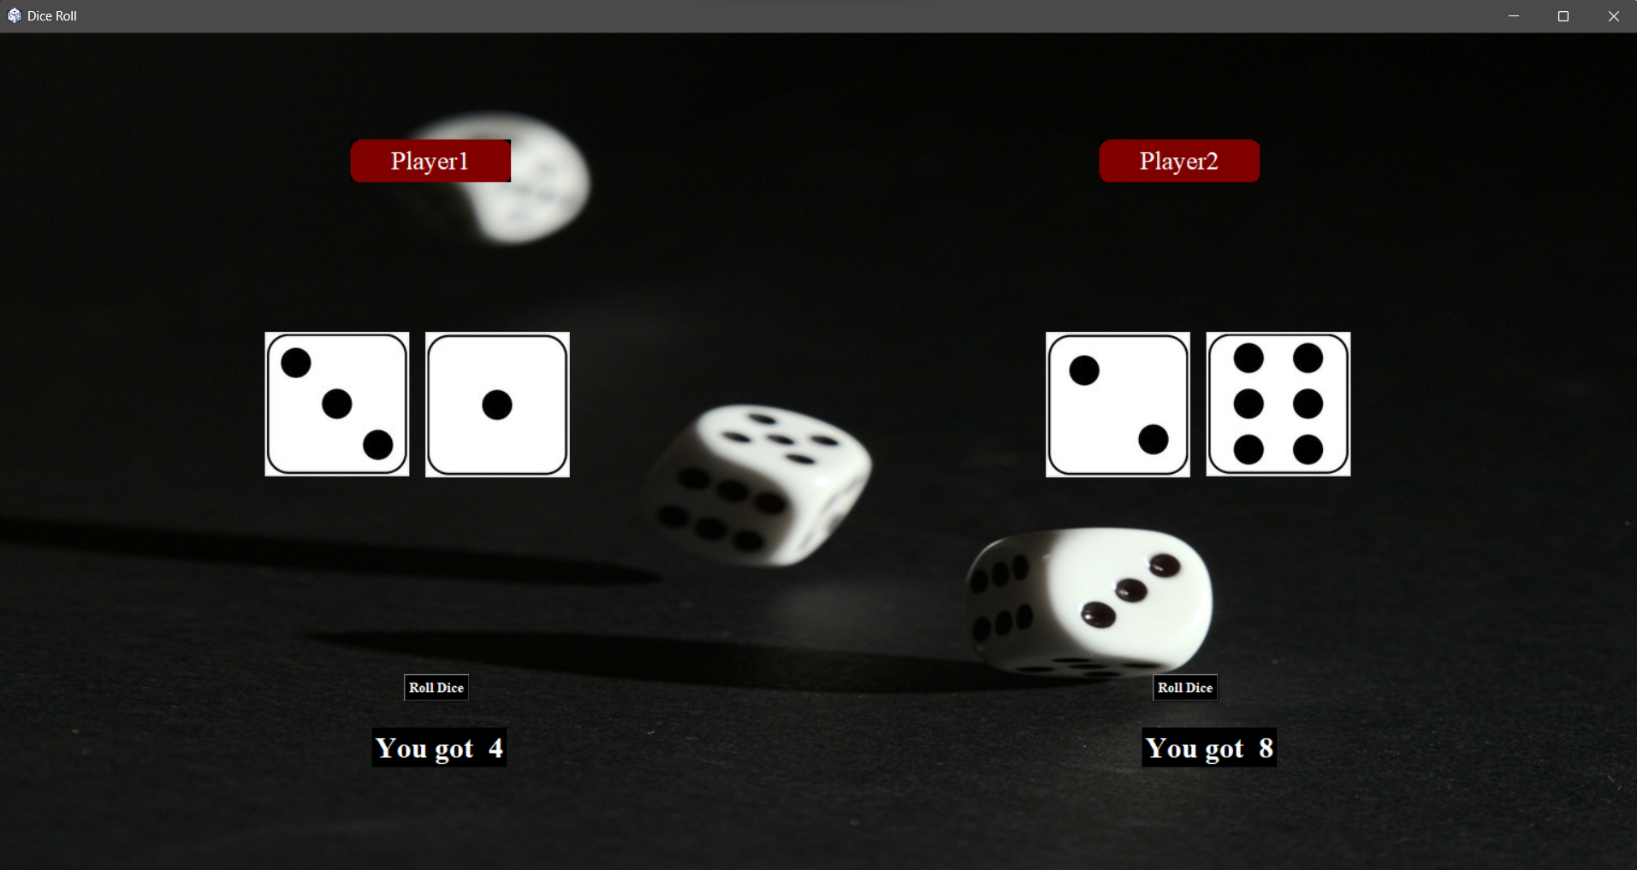
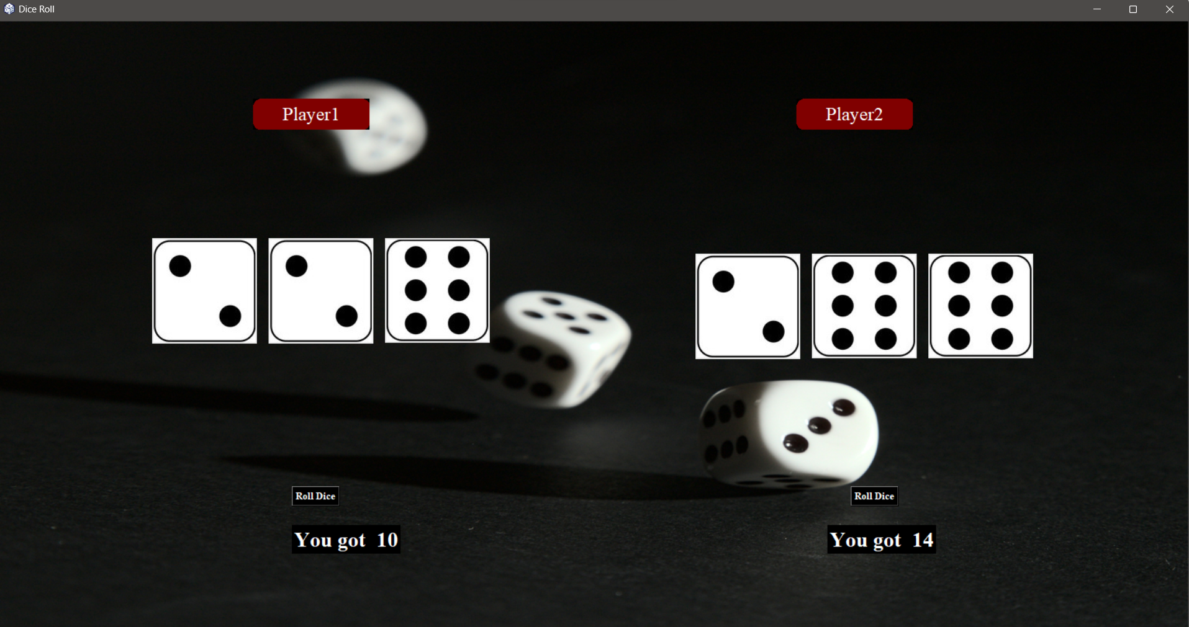
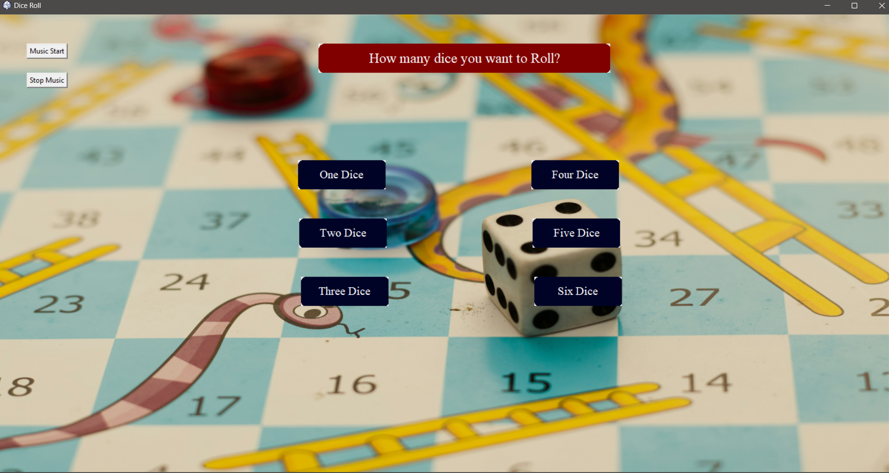
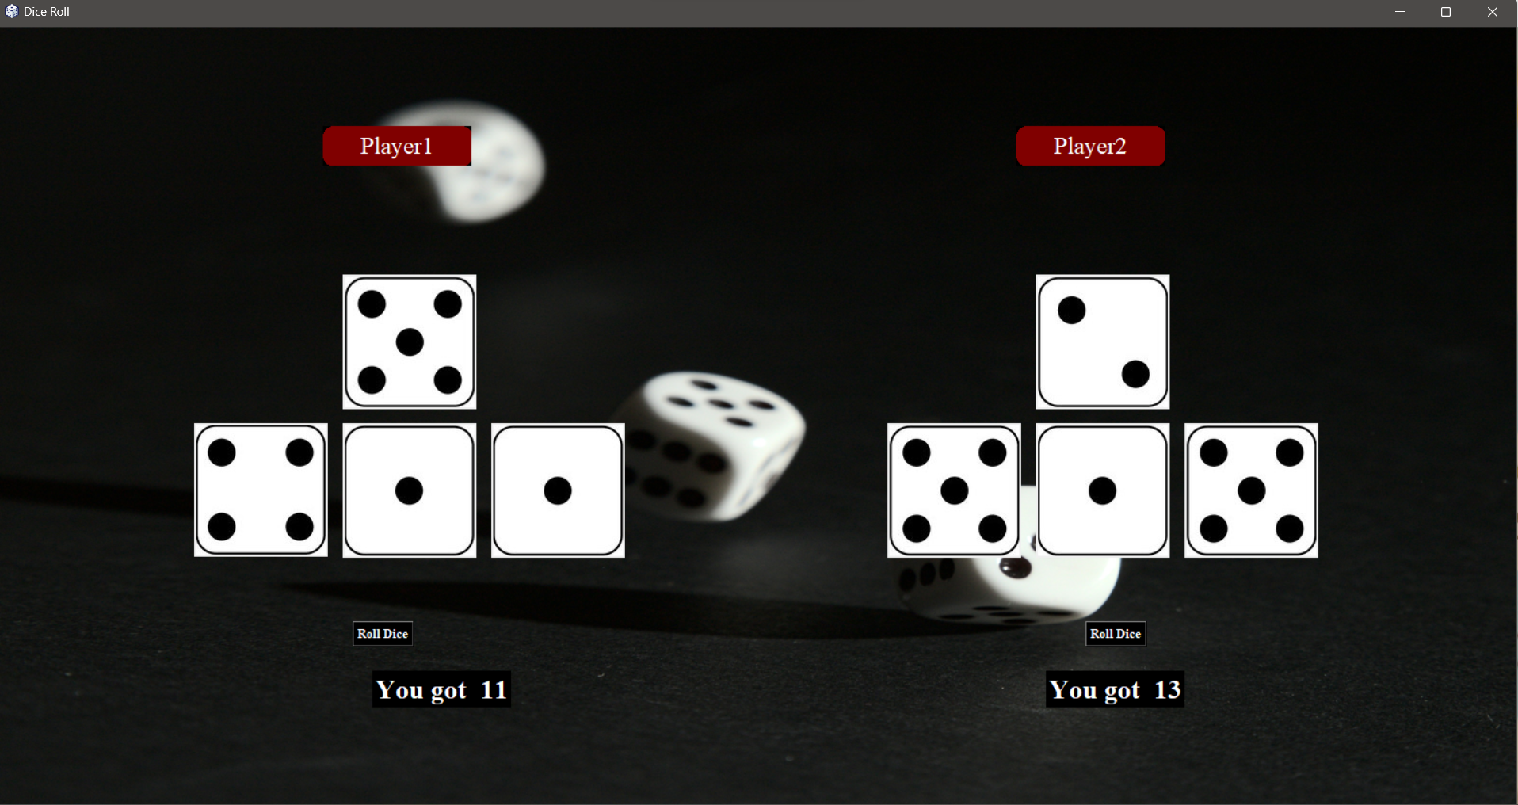
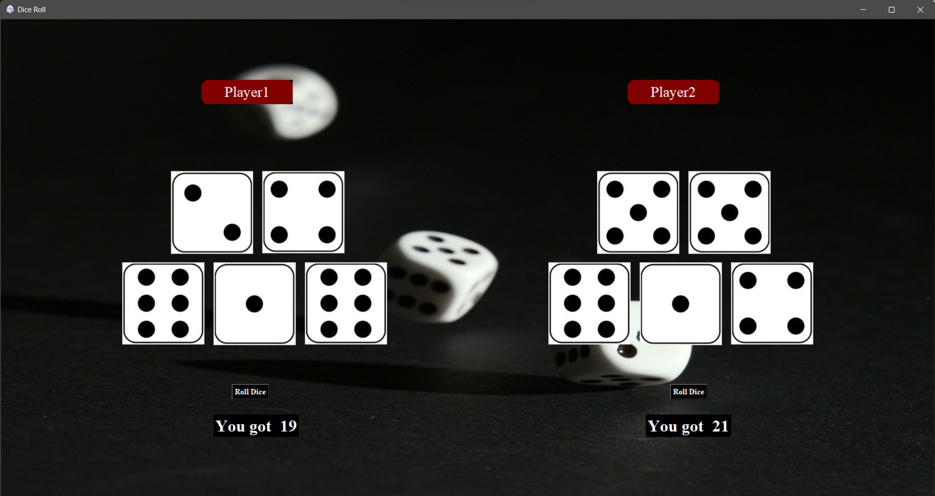
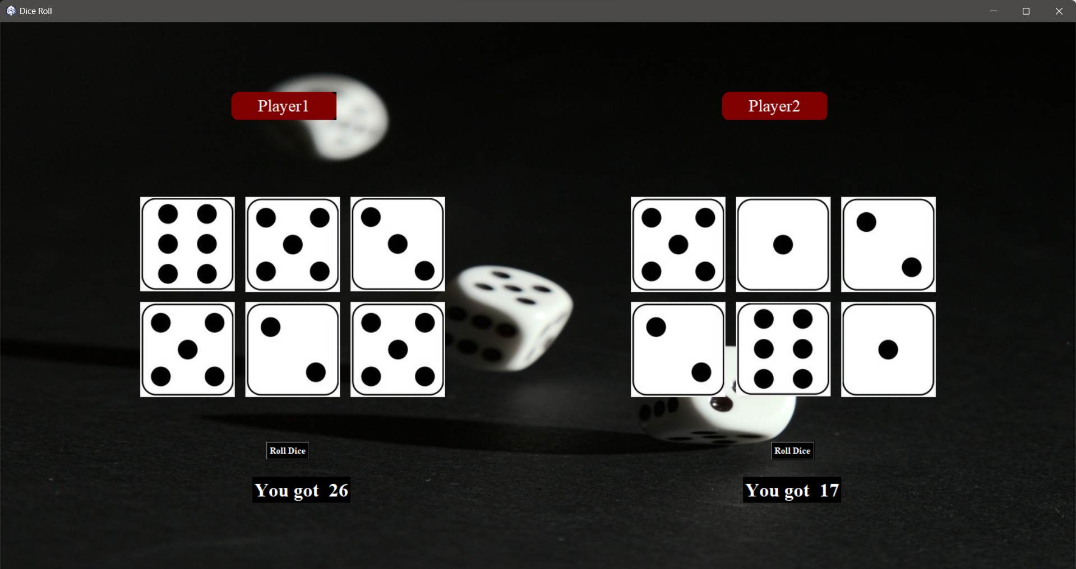
Design
One Dice Page
Two Dice Page
Three Dice Page
Menu Page
Four Dice Page
Five Dice Page
Six Dice Page

Slide 7
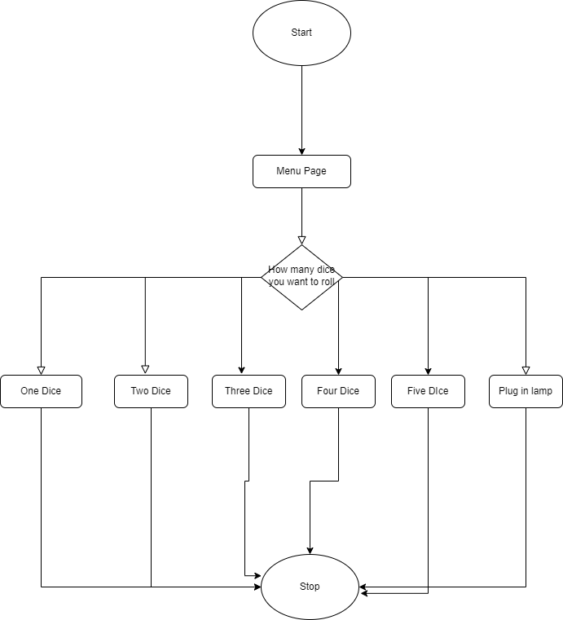
Flow Chart

Slide 8
Software
Vs code:
Visual Studio Code, also commonly referred to as VS Code, is a source-code editor developed by Microsoft for Windows, Linux and macOS. Features include support for debugging, syntax highlighting, intelligent code completion, snippets, code refactoring, and embedded Git. Users can change the theme, keyboard shortcuts, preferences, and install extensions that add functionality.
In the Stack Overflow 2023 Developer Survey, Visual Studio Code was ranked the most popular developer environment tool among 86,544 respondents, with 73.71% reporting that they use it. The survey also found Visual Studio Code to be used more by those learning to code than by professional developers (78% vs. 74%)

Slide 9
Hardware
Visual Studio Code is a small download (< 200 MB) and has a disk footprint of < 500 MB. VS Code is lightweight and should easily run on today's hardware.
We recommend:
1.6 GHz or faster processor
1 GB of RAM

Slide 10
Platform
VS Code is supported on the following platforms:
Windows 10 and 11 (64-bit)
macOS versions with Apple security update support. This is typically the latest release and the two previous versions.
Linux (Debian): Ubuntu Desktop 20.04, Debian 10
Linux (Red Hat): Red Hat Enterprise Linux 8, Fedora 36

Slide 11
Tools & Technologies
VS Code
Python Language
Tkinter Library
Pillow Library
Pygame
customtkinter

Slide 12
Future Work
In Future we will manage the game for multiplayers on online. We will improve the game by developing a mobile Game where user can install the game into it’s mobile device.

Slide 13
Documentation

Slide 14
ABstract
The "Dice Rolling Simulator in Python" case study explores the development of a simple yet engaging program that allows users to simulate the roll of one or more dice. Leveraging Python's random number generation capabilities, the simulator provides users with a chance-based experience reminiscent of real-world dice games.

Slide 15
Validation & Verification
The Dice Rolling Game goes under the process of validation and verification to make the game more efficient and user friendly. We test the game with different user which makes them to attract with the game and became relax. We also used it in the real life LUDO game where it also makes a good impact.

Slide 16
Result
The Dice Rolling game makes a good impression on our test users. Where they loved to play with that game. It’s user friendly interface makes them to attract on the software. It’s different choice of dice makes them to use the game more efficiently and it also makes a good impact on the user to make them stress free.

Slide 17
conclusion
In Conclusion, The Dice Rolling game is validate with different real life Ludo game, It’s user-friendly interface makes it more efficient. It gives a good impact on the test users.

Slide 18
References
https://www.youtube.com/watch?v=CIm5vfsfgO0&ab_channel=WsCubeTech
https://docs.python.org/3/library/tkinter.html
https://pypi.org/project/pygame/
https://pypi.org/project/customtkinter/
https://pypi.org/project/pillow/

